Slide 1
ML/DL-based biomedical signal analysis and processing for disease identification and related hardware implementation
Presented By: Archana Kumari & Shwashwat Das
Supervisor: Prof. Sumitra Mukhopadhyay
Institute of Radiophysics and Electronics
University of Calcutta
October 30, 2023

Slide 2
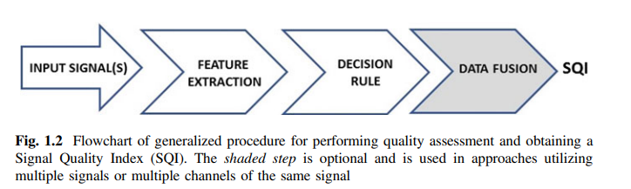
Introduction To signal quality assessment (Sqa)
37% of the European population is expected to be aged 60 or over by 2050
Outside the context of clinical monitoring, wearable sensors, “digital patch” devices, “Smart” garments, and ambient and contactless monitoring are gaining momentum, but the quality of signals is decreasing.
Challenges to overcome:
Reliability of wireless technology,
Quality of measurements,
Power management of wearable monitors,
Security, and patient confidentiality.
Patient and clinician acceptance is an important barrier.
Fig1 - Source: Christina Orphanidou Signal Quality Assessment in Physiological Monitoring State of the Art and Practical Considerations
Challenges and Future Directions
Distinguishing between signal artefacts from pathophysiological changes
Algorithms generalizing to heterogeneous clinical settings and sensors
Reducing data retention
Minimizing computational power

Slide 3
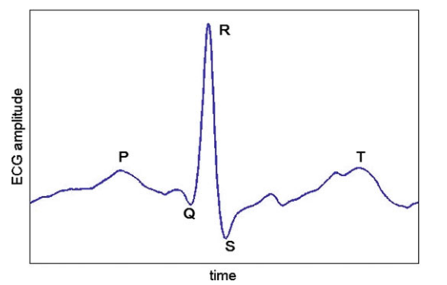
methodology
PPG
Measures the volume changes in blood as it moves from the heart toward the periphery and specially the measurement site. E.g fingertips.
First step is beat detection.
Second we apply feasibility checks
Physiological Viability
Clipping/Signal Saturation detection
Morphological features
ECG
The ECG records electrical potential differences between prescribed locations on the surface of the body using skin electrodes
Feasibility checks:
Flat Line Detection: Real ECG is never constant.
Skewness and kurtosis of the ECG
Variability in the R-R Interval
Noise-Power Measurements:
Root mean square (RMS) power
Ratio of the R-peak amplitude to the noise amplitude
Ratio of the peak value of a signal to its RMS value.
Fig2 - Source: Christina Orphanidou Signal Quality Assessment in Physiological Monitoring State of the Art and Practical Considerations
Notes:
PPG: 1st pnt: there are no general aaproach for peak detection for ppg
2nd :to quickly identify unacceptable segments

Slide 4
Machine learning Models used in ecg:
The author extracted 7 morphological, spectral, and statistical features from 12 channels of simultaneously recorded ECG resulting in 84 features in total.
A classifier was then trained using SVM also with an RBF kernel and a standard Multi-Layer Perceptron Neural Network (MLPNN). Classifiers were first tested using all 84 features and then using only the 7 features from a single lead.
For the single-lead classifiers the results from the MLP and SVMs were almost the same, with the SVM approach slightly outperforming the MLP, with a classification accuracy of 96.5%, Sensitivity of 97.2%, and Specificity of 95.8% on the test set using only four features.
For the 12-lead case, the best classification accuracy occurred when using five features using the MLP, with an accuracy of 95.9% on the test set

